Slide 1



Course Code: CSE 3107 Course Title: Communication Engineering
Dr. Foez Ahmed, SMIEE
Associate Professor | Dept. of ICE
University of Rajshahi, Rajshahi-6205
Email: foez28@ru.ac.bd
Arifa Ferdousi
Lecturer| Dept. of ICE
University of Rajshahi, Rajshahi-6205
Email:
Zannatul Mifta
Lecturer| Dept. of CSE
Varendra University
Email: mifta@vu.edu.bd

Slide 2
Lecture # 04-05 Amplitude Modulation
Outline____
Amplitude Modulation
Amplitude Modulation Index
Frequency Spectrum for Sinusoidal AM

Slide 3
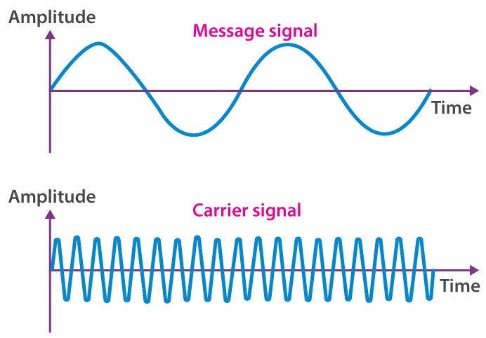
Modulation
Modulation and Demodulation?
Modulation is a process of varying the characteristics of a carrier signal (like amplitude, frequency, or phase) in accordance with a message signal (also called modulating signal).
It is the process of encoding information from a message source in a way that is suitable for transmission.
Demodulation is the process of extracting the original information-bearing signal or message signal from a modulated carrier wave.
It is the reverse of modulation.

Slide 4
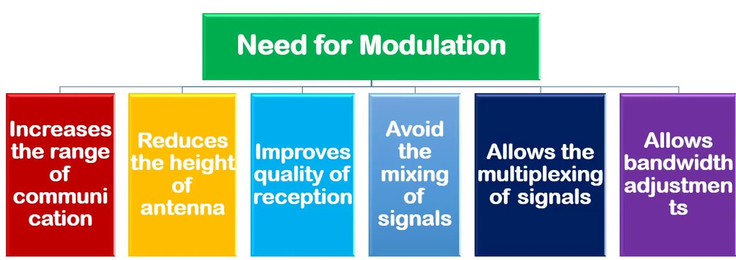
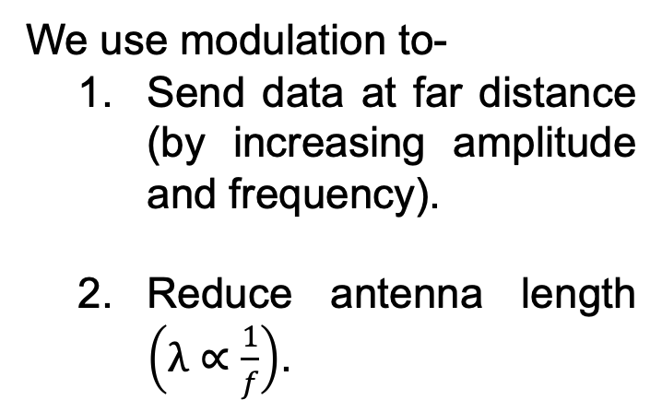
Modulation
Why Do We Need Modulation?
We use modulation to-
Send data at far distance (by increasing amplitude and frequency).
Reduce antenna length $\left(λ∝\frac{1}{f}\right)$.
3. Remove interference, by modulating at different frequencies.
4. Transmit multiple channels of information through a single communication medium

Slide 5
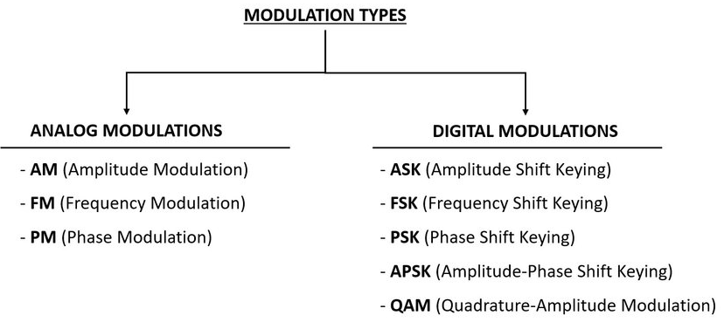
Modulation
Types of Modulation?

Slide 6
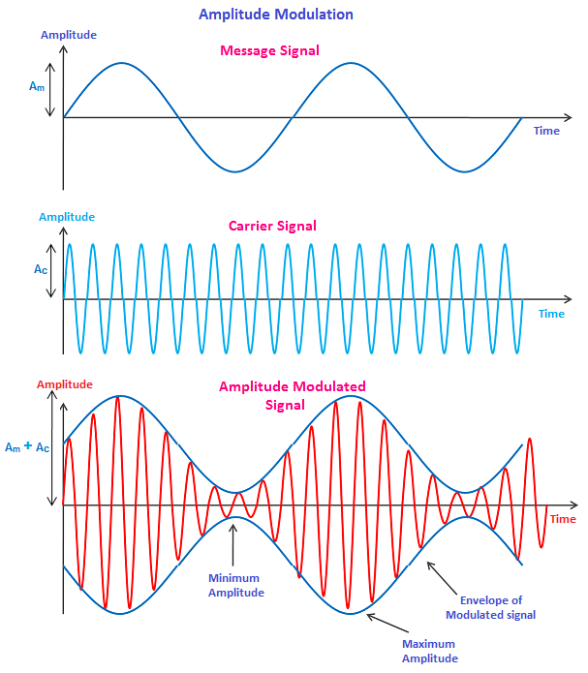
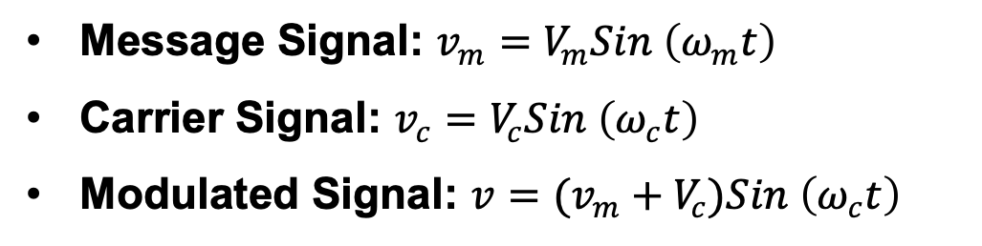
Amplitude Modulation
Amplitude Modulation?
Amplitude modulation is the modulation process where the amplitude of the carrier signal is varied with respect to the instantaneous amplitude of the message signal (modulating voltage).
Example: AM Radio Broadcasting, Analog TV Transmission.
Message Signal: $v_{m}=V_{m}Sin \left(ω_{m}t\right)$
Carrier Signal: $v_{c}=V_{c}Sin \left(ω_{c}t\right)$
Modulated Signal: $v=(v_{m}+V_{c})Sin \left(ω_{c}t\right)$

Slide 7
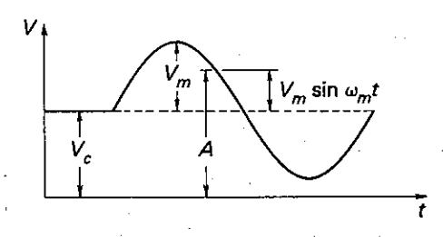
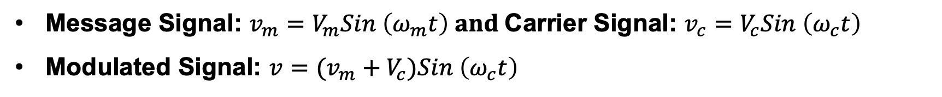
Amplitude Modulation
Amplitude Modulation?
Message Signal: $v_{m}=V_{m}Sin \left(ω_{m}t\right) and$Carrier Signal: $v_{c}=V_{c}Sin \left(ω_{c}t\right)$
Modulated Signal: $v=(v_{m}+V_{c})Sin \left(ω_{c}t\right)$

Slide 8
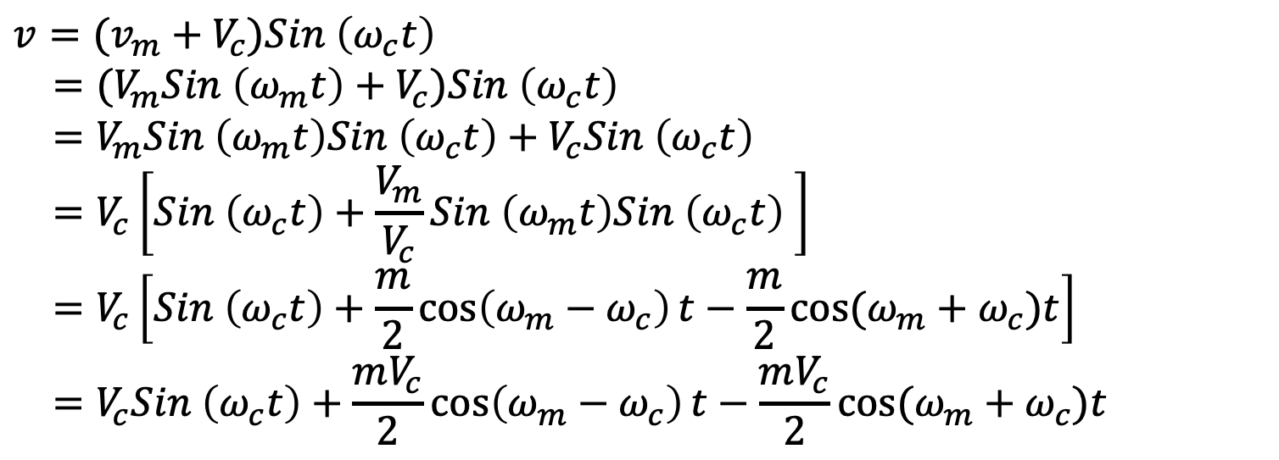
Amplitude Modulation
Frequency Spectrum
$$v=(v_{m}+V_{c})Sin \left(ω_{c}t\right)$$
$$=(V_{m}Sin \left(ω_{m}t\right)+V_{c})Sin \left(ω_{c}t\right)$$
$$=V_{m}Sin \left(ω_{m}t\right)Sin \left(ω_{c}t\right)+V_{c}Sin \left(ω_{c}t\right)$$
$$=V_{c}\left[Sin \left(ω_{c}t\right)+\frac{V_{m}}{V_{c}}Sin \left(ω_{m}t\right)Sin \left(ω_{c}t\right) \right]$$
$$=V_{c}\left[Sin \left(ω_{c}t\right)+\frac{m}{2}\cos\left(ω_{m}−ω_{c}\right)t−\frac{m}{2}cos⁡(ω_{m}+ω_{c})t\right]$$
$$=V_{c}Sin \left(ω_{c}t\right)+\frac{mV_{c}}{2}\cos\left(ω_{m}−ω_{c}\right)t−\frac{mV_{c}}{2}cos⁡(ω_{m}+ω_{c})t$$
Carrier
Lower Side Band
Upper Side Band
Here, m is the modulation index [$m≤1$].

Slide 9
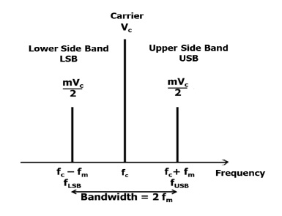
Amplitude Modulation
Frequency Spectrum
Modulation index, m= Vm/Vc
The modulation index is a measure of the extent of modulation.
When
m<1, Under-modulation (low signal strength)
m=1, Perfect modulation (ideal case)
m>1, Over-modulation (causes distortion and loss of information)

Slide 10
Amplitude Modulation
Modulation Index:
Modulation index, m= Vm/Vc
The modulation index is a measure of the extent of modulation.
When
m<1, Under-modulation (low signal strength)
m=1, Perfect modulation (ideal case)
m>1, Over-modulation (causes distortion and loss of information)

Slide 11
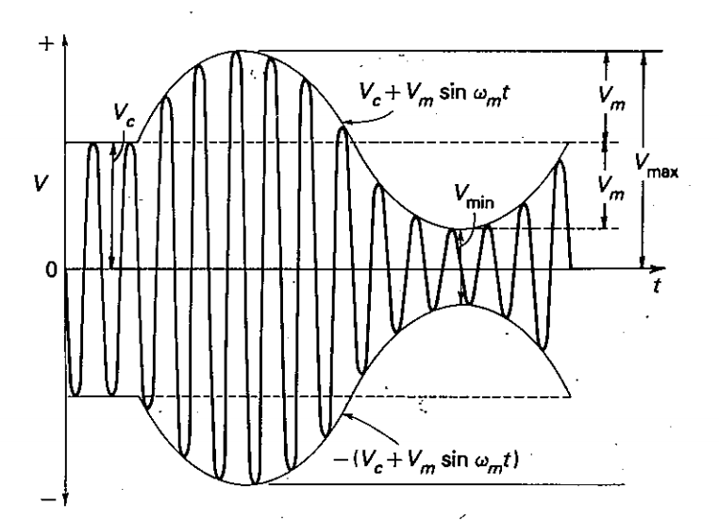

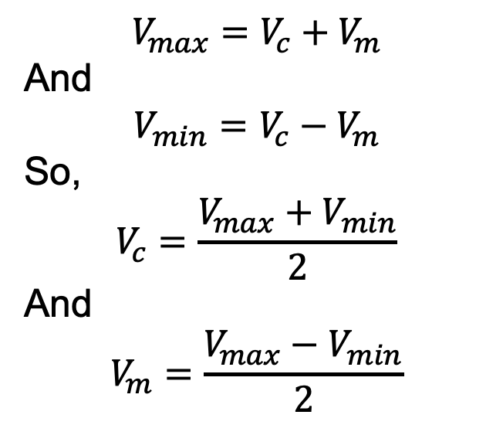
Amplitude Modulation
Modulation Index:
$$V_{max}=V_{c}+V_{m}$$
And
$$V_{min}=V_{c}−V_{m}$$
So,
$$V_{c}=\frac{V_{max}+V_{min}}{2}$$
And
$$V_{m}=\frac{V_{max}−V_{min}}{2}$$
Modulation Index:
$$m=\frac{V_{max}−V_{min}}{V_{max}+V_{min}}$$

Slide 12
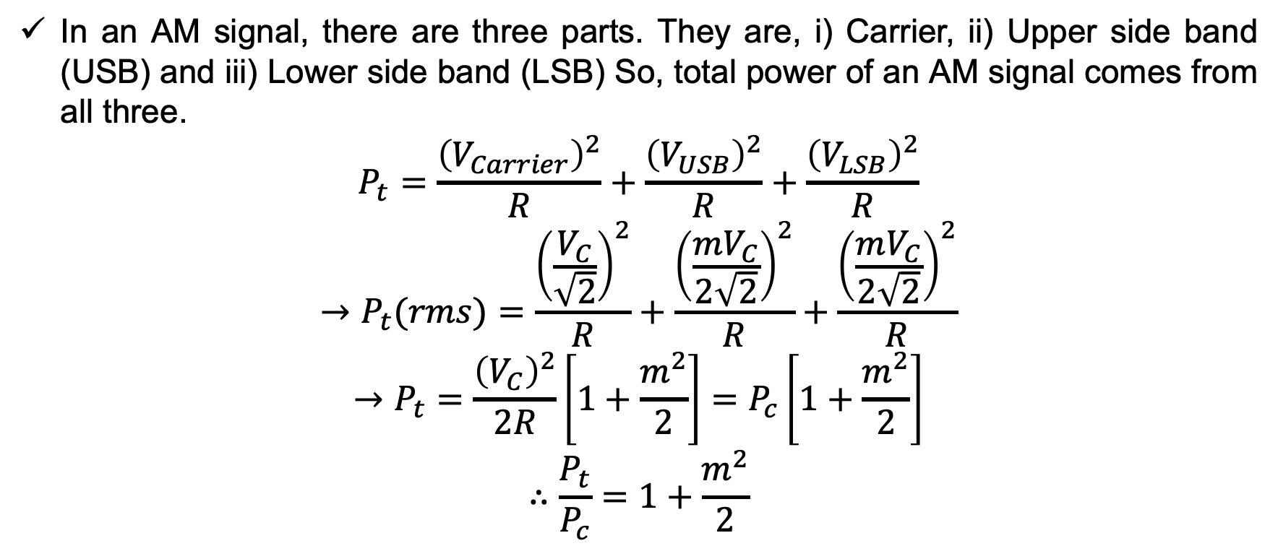
Amplitude Modulation
Power of AM Signal:
In an AM signal, there are three parts. They are, i) Carrier, ii) Upper side band (USB) and iii) Lower side band (LSB) So, total power of an AM signal comes from all three.
$$P_{t}=\frac{{\left(V_{Carrier}\right)}^{2}}{R}+\frac{{\left(V_{USB}\right)}^{2}}{R}+\frac{{\left(V_{LSB}\right)}^{2}}{R}$$
$$→P_{t}(rms)=\frac{{\left(\frac{V_{C}}{\sqrt{2}}\right)}^{2}}{R}+\frac{{\left(\frac{mV_{C}}{2\sqrt{2}}\right)}^{2}}{R}+\frac{{\left(\frac{mV_{C}}{2\sqrt{2}}\right)}^{2}}{R}$$
$$→P_{t}=\frac{{\left(V_{C}\right)}^{2}}{2R}\left[1+\frac{m^{2}}{2}\right]=P_{c}\left[1+\frac{m^{2}}{2}\right]$$
$$∴\frac{P_{t}}{P_{c}}=1+\frac{m^{2}}{2}$$
Notes:
Carrier RMS voltage:
$$V_{C,\text{rms}}=\frac{V_{C}}{\sqrt{2}}$$
$$P_{C}=\frac{V_{C}^{2}}{2R}$$
Similarly, for Both SB!

Slide 13
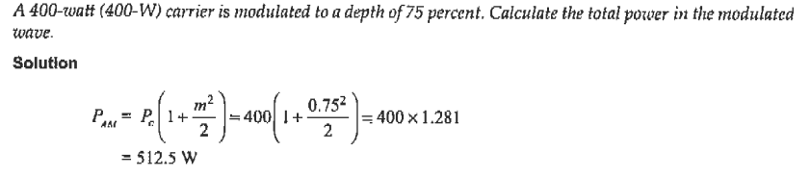
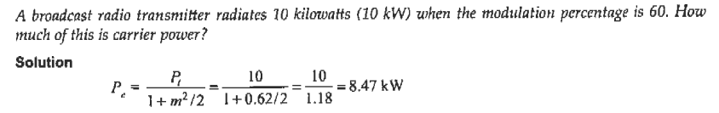
Amplitude Modulation
Power of AM Signal (Problem Solving Examples):

Slide 14
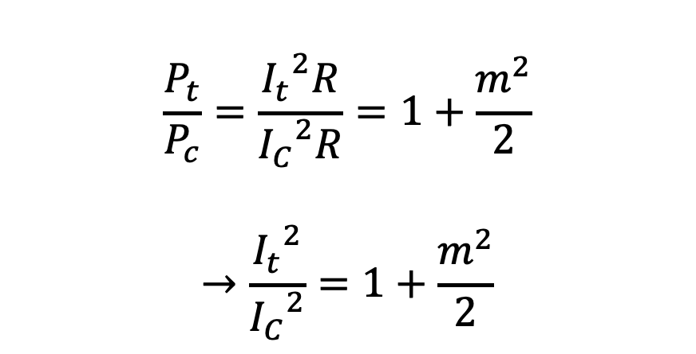

Amplitude Modulation
Current of AM Signal:
Let I_{c}, be the unmodulated current and It, the total, or modulated, current of an AM transmitter, both being rms values. If R is the resistance in which these currents flow, then,
$$→\frac{I_{t}}{I_{C}}=\sqrt{1+\frac{m^{2}}{2}}$$
$$∴I_{t}=I_{C}\sqrt{1+\frac{m^{2}}{2}}$$
$$\frac{P_{t}}{P_{c}}=\frac{{I_{t}}^{2}R}{{I_{C}}^{2}R}=1+\frac{m^{2}}{2}$$
$$→\frac{{I_{t}}^{2}}{{I_{C}}^{2}}=1+\frac{m^{2}}{2}$$

Slide 15
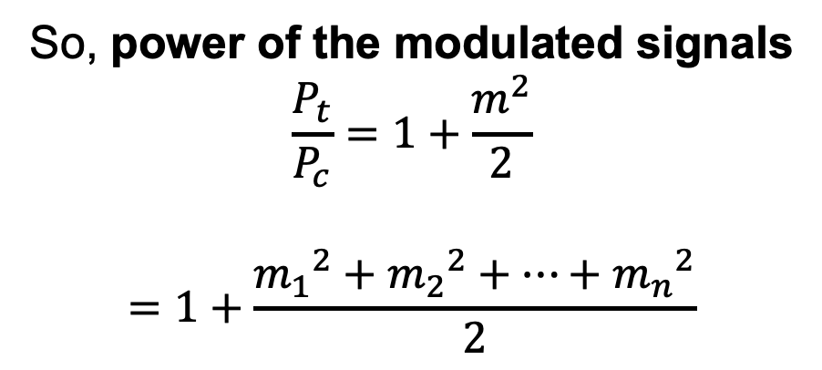
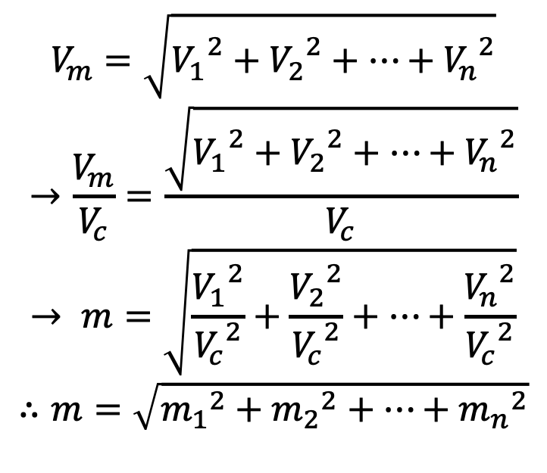
Amplitude Modulation
Modulation by Several Sine Waves:
Let, there are “n” number of sine waves namely $V_{1}$, $V_{2}$, …, $V_{n}$ modulating a single carrier wave. So, we take the rms value of all the modulating signals.
$$V_{m}=\sqrt{{V_{1}}^{2}+{V_{2}}^{2}+…+{V_{n}}^{2}}$$
$$→\frac{V_{m}}{V_{c}}=\frac{\sqrt{{V_{1}}^{2}+{V_{2}}^{2}+…+{V_{n}}^{2}}}{V_{c}}$$
$$→ m=\sqrt{\frac{{V_{1}}^{2}}{{V_{c}}^{2}}+\frac{{V_{2}}^{2}}{{V_{c}}^{2}}+…+\frac{{V_{n}}^{2}}{{V_{c}}^{2}}}$$
$$∴m=\sqrt{{m_{1}}^{2}+{m_{2}}^{2}+…+{m_{n}}^{2}}$$
So, power of the modulated signals
$$\frac{P_{t}}{P_{c}}=1+\frac{m^{2}}{2}$$
$$=1+\frac{{m_{1}}^{2}+{m_{2}}^{2}+…+{m_{n}}^{2}}{2}$$

Slide 16
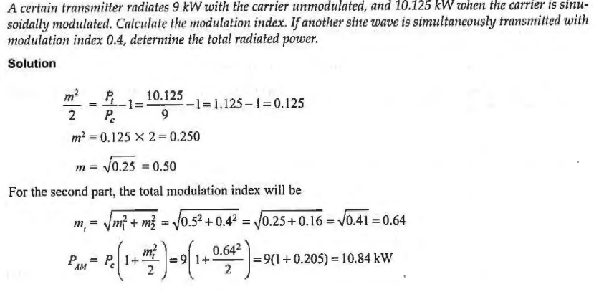
Amplitude Modulation
Modulation by Several Sine Waves (Problem Solving Examples):

Slide 17
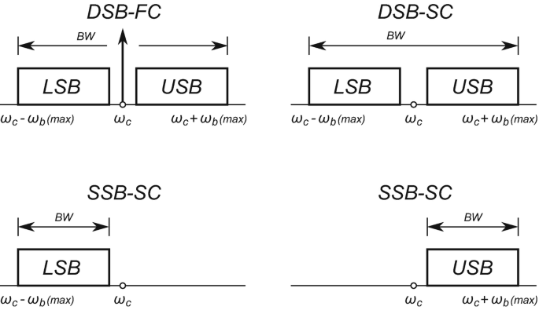
Amplitude Modulation
Types of Amplitude Modulation:
Double Sideband Full Carrier (DSB-FC):
Standard AM
Contains carrier + both sidebands
Double Sideband Suppressed Carrier (DSB-SC)
No carrier
Requires coherent detection

Slide 18
Amplitude Modulation
Types of Amplitude Modulation:
SSB (Single Sideband)
Only one sideband is transmitted (USB or LSB)
More bandwidth and power efficient

Slide 19
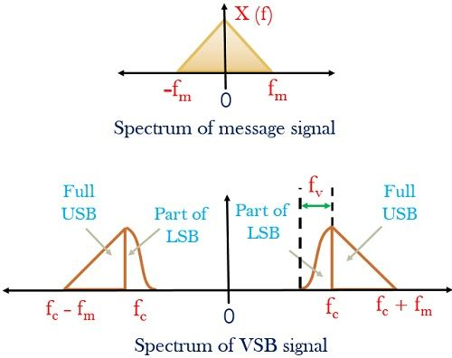
Amplitude Modulation
Types of Amplitude Modulation:
Vestigial Sideband (VSB)
One full sideband and part of the other (LSB/USB)
Used in TV broadcasting

Slide 20
Amplitude Modulation
$$v=V_{c}Sin \left(ω_{c}t\right)+\frac{mV_{c}}{2}\cos\left(ω_{m}−ω_{c}\right)t−\frac{mV_{c}}{2}cos(ω_{m}+ω_{c})t$$
SSB-SC:
Carrier
Lower Side Band
Upper Side Band
The process of suppressing one of the sidebands along with the carrier and transmitting a single sideband is called as Single Sideband Suppressed Carrier system or simply SSB-SC.

Slide 21
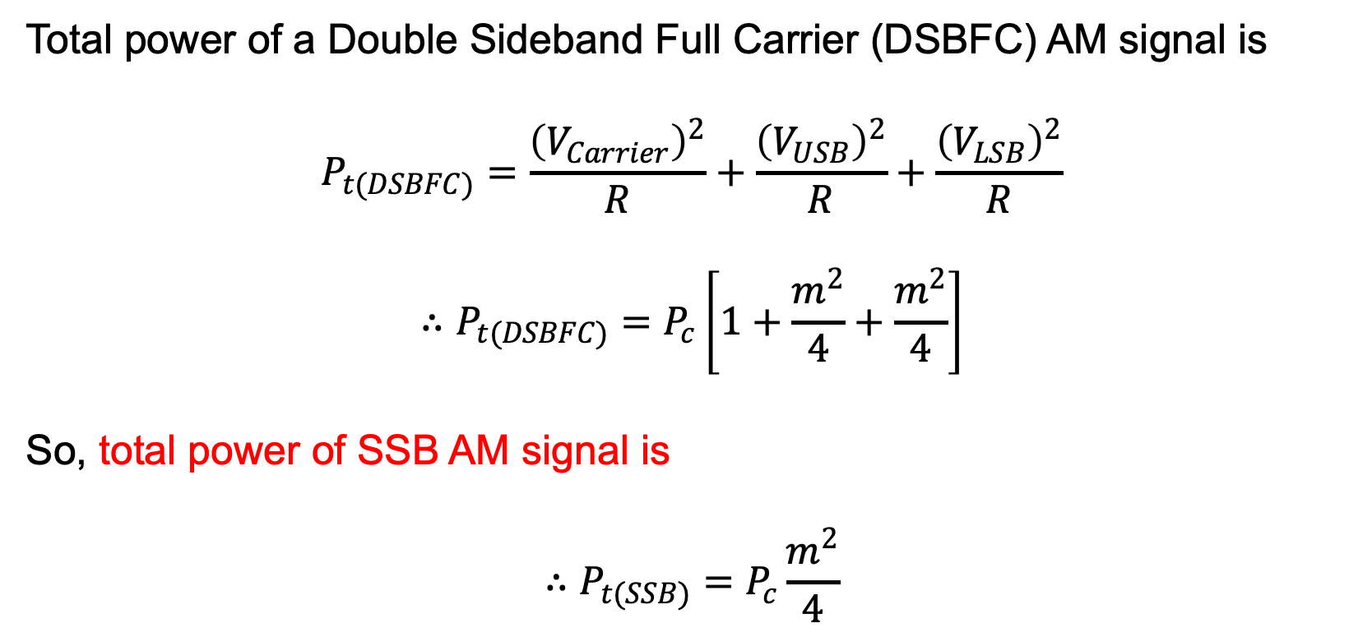
Amplitude Modulation
Advantages of SSB-SC:
Total power of a Double Sideband Full Carrier (DSBFC) AM signal is
$$P_{t(DSBFC)}=\frac{{\left(V_{Carrier}\right)}^{2}}{R}+\frac{{\left(V_{USB}\right)}^{2}}{R}+\frac{{\left(V_{LSB}\right)}^{2}}{R}$$
$$∴P_{t(DSBFC)}=P_{c}\left[1+\frac{m^{2}}{4}+\frac{m^{2}}{4}\right]$$
So, total power of SSB AM signal is
$$∴P_{t(SSB)}=P_{c}\frac{m^{2}}{4}$$

Slide 22
Amplitude Modulation
SSB-SC: Is removing of a band and carrier allowed?
The carrier is removed because it does not transmit any information.
The remaining sidebands are actually mirror to each other, transmitting the same information.
So, information can be sent using a single side band.

Slide 23
Amplitude Modulation
Advantages of SSB-SC:
Power is saved.
High power signal can be transmitted.
Bandwidth or spectrum space occupied is lesser than standard AM and DSB-SC waves.
Transmission of a greater number of signals is allowed.
Less amount of noise is present.
Signal fading is less likely to occur.

Slide 24
Amplitude Modulation
Disadvantages of SSB-SC:
The discovery & generation process of the single-sideband signal is complex.
Higher Cost
Signal quality will be affected when the transmitter & receiver of SSB have outstanding frequency strength

Slide 25
Amplitude Modulation
Methods of Suppressing Carrier and Unwanted Sideband:
Three (3) main systems are employed for the generation of SSB (i.e., for the suppression of carrier and unwanted sideband). They are:
Filter Method
Phase Shift (or Cancellation) Method
The third Method

Slide 26
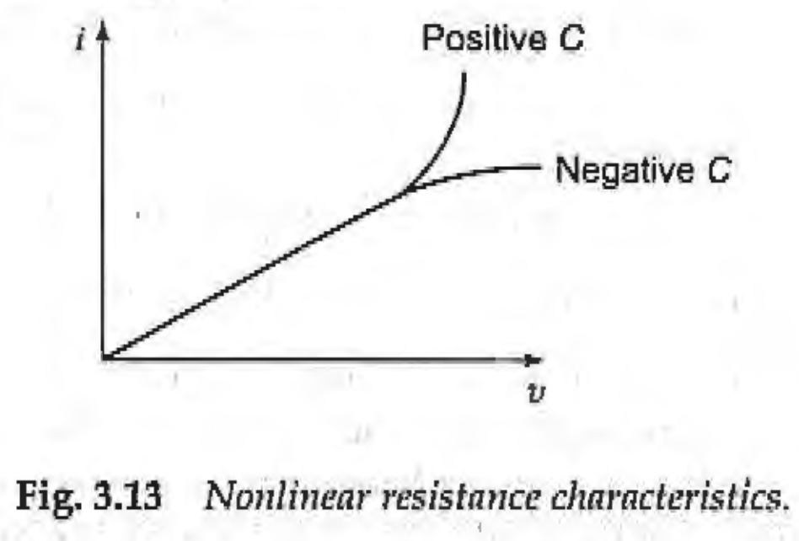


Amplitude Modulation
Effect of Nonlinear Resistance on Added Signal
The relationship between voltage and current in a linear resistance is -
$$i=bv$$
where b is some constant of proportionality.
In-a nonlinear resistance (Using a Nonlinear Resistance Device, e.g., Diode, Transistor, FET), the current is still to a certain extent proportional to the applied voltage, but no longer directly as before.
Current now becomes proportional not only to voltage but also to the square, cube and higher powers of voltage.
This nonlinear relation is most conveniently expressed as
$i=a+bv+cv^{2}+dv^{3}$+ higher powers

Slide 27
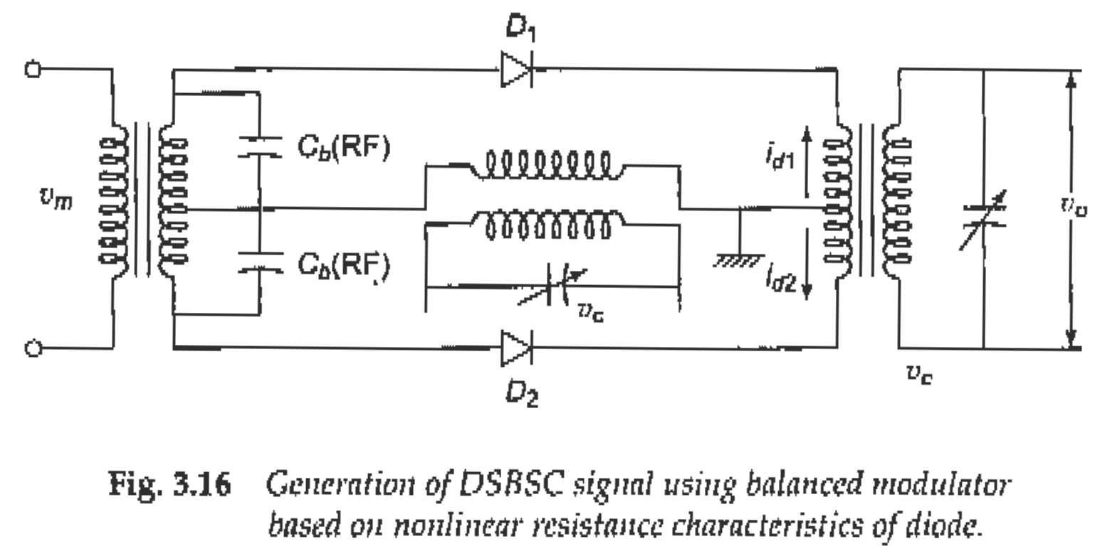
Amplitude Modulation
Methods of Suppressing Carrier: The Balanced Modulator
Fig. 3.16 Generation of DSBSC signal using balanced modulator based on nonlinear resistance characteristics of diode

Slide 28

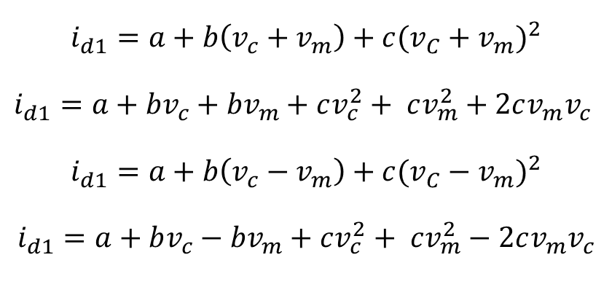
Amplitude Modulation
Methods of Suppressing Carrier: The Balanced Modulator
As indicated, the input voltage will be (v_{m}+ v_{c}) at the input of diode D1 and (v_{m} - v_{c}) at the input of diode D2.
The two diode output currents will be
$$i_{d1}=a+b\left(v_{c}+v_{m}\right)+c{(v_{C}+v_{m})}^{2}$$
$i_{d1}=a+bv_{c}+{bv}_{m}+cv_{c}^{2}+ cv_{m}^{2}+2cv_{m}v_{c}$
$$i_{d1}=a+b\left(v_{c}−v_{m}\right)+c{(v_{C}−v_{m})}^{2}$$
$$i_{d1}=a+bv_{c}−{bv}_{m}+cv_{c}^{2}+ cv_{m}^{2}−2cv_{m}v_{c}$$
Thus, the primary current will be
$$i_{1}=i_{d1}−i_{d2}=2bv_{m}+4cv_{m}v_{c}$$

Slide 29
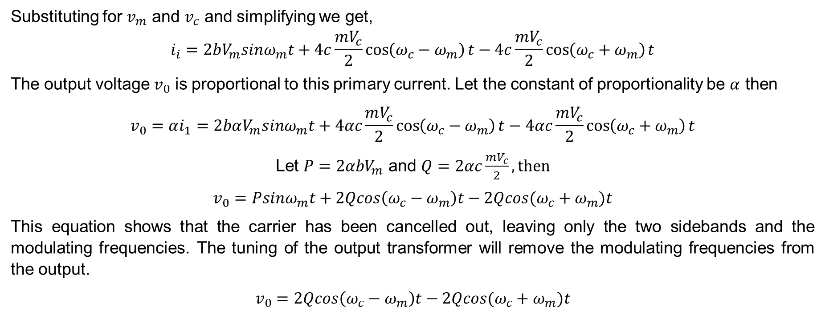
Amplitude Modulation
Methods of Suppressing Carrier: The Balanced Modulator
Substituting for $v_{m}$ and $v_{c}$ and simplifying we get,
$$i_{i}=2bV_{m}sinω_{m}t+4c\frac{mV_{c}}{2}\cos\left(ω_{c}−ω_{m}\right)t−4c\frac{mV_{c}}{2}\cos\left(ω_{c}+ω_{m}\right)t$$
The output voltage $v_{0}$ is proportional to this primary current. Let the constant of proportionality be $α$ then
$$v_{0}=αi_{1}=2bαV_{m}sinω_{m}t+4αc\frac{mV_{c}}{2}\cos\left(ω_{c}−ω_{m}\right)t−4αc\frac{mV_{c}}{2}\cos\left(ω_{c}+ω_{m}\right)t$$
Let $P=2αbV_{m}$ and $Q=2αc\frac{mV_{c}}{2}, then$
$$v_{0}=Psinω_{m}t+2Qcos\left(ω_{c}−ω_{m}\right)t−2Qcos(ω_{c}+ω_{m})t$$
This equation shows that the carrier has been cancelled out, leaving only the two sidebands and the modulating frequencies. The tuning of the output transformer will remove the modulating frequencies from the output.
$$v_{0}=2Qcos\left(ω_{c}−ω_{m}\right)t−2Qcos(ω_{c}+ω_{m})t$$

Slide 30
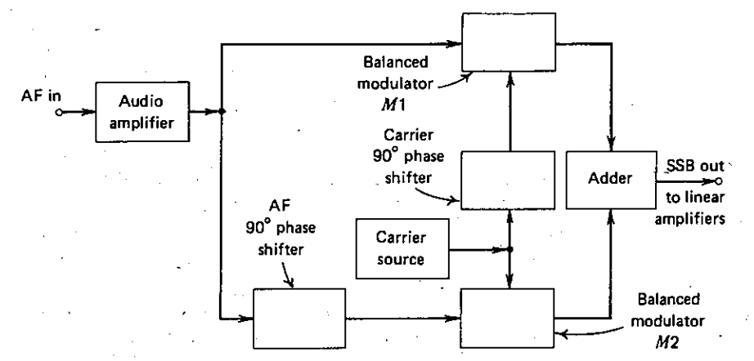

Amplitude Modulation
Methods of Suppressing SB: The Phase Shift Method
$$V_{m}sin⁡(ω_{m}t+90°)$$

Slide 31
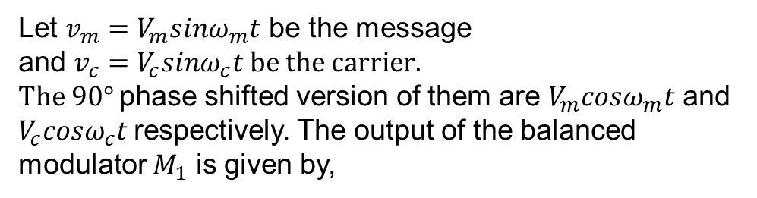

Amplitude Modulation
Methods of Suppressing SB: The Phase Shift Method
Let $v_{m}=V_{m}sinω_{m}t$ be the message
and $v_{c}=V_{c}sinω_{c}t be the carrier.$
$The 90°$phase shifted version of them are $V_{m}cosω_{m}t$ and $V_{c}cosω_{c}t$respectively. The output of the balanced modulator $M_{1}$ is given by,
$$v_{1}=V_{m}V_{c}sinω_{m}tcosω_{c}t=\frac{V_{m}V_{c}}{2}(\sin\left(ω_{c}+ω_{m}\right)t+sin\left(ω_{c}−ω_{m}\right)t)$$
$$V_{m}sin⁡(ω_{m}t+90°)$$

Slide 32
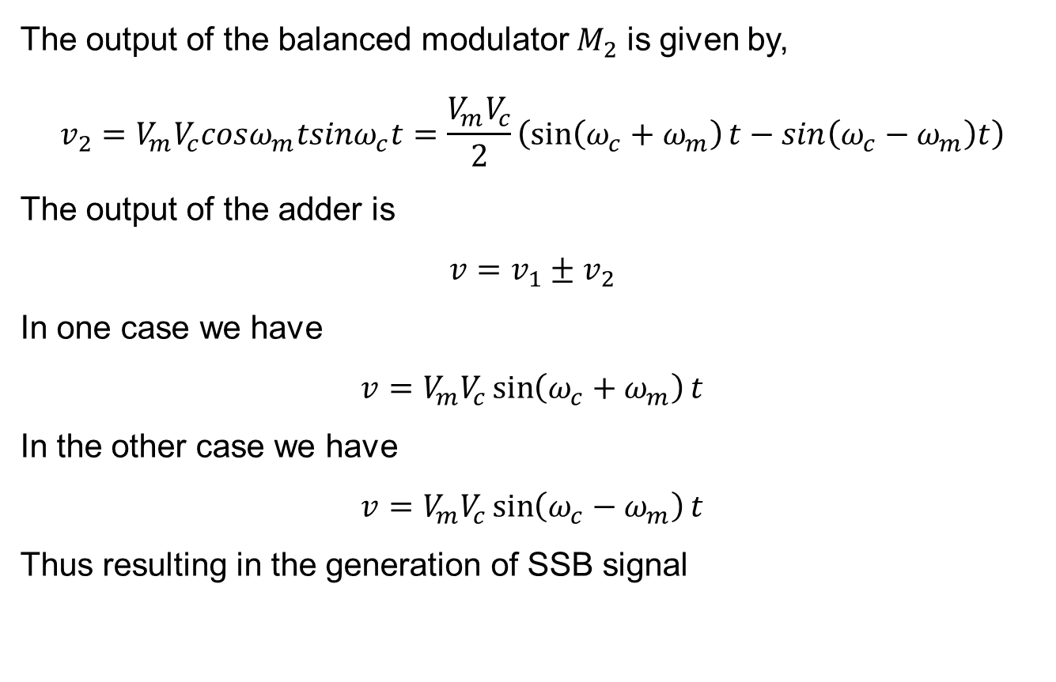
Amplitude Modulation
Methods of Suppressing SB: The Phase Shift Method
The output of the balanced modulator $M_{2}$ is given by,
$$v_{2}=V_{m}V_{c}cosω_{m}tsinω_{c}t=\frac{V_{m}V_{c}}{2}\left(\sin\left(ω_{c}+ω_{m}\right)t−sin\left(ω_{c}−ω_{m}\right)t\right)$$
The output of the adder is
$$v=v_{1}±v_{2}$$
In one case we have
$$v=V_{m}V_{c}\sin\left(ω_{c}+ω_{m}\right)t$$
In the other case we have
$$v=V_{m}V_{c}\sin\left(ω_{c}−ω_{m}\right)t$$
Thus resulting in the generation of SSB signal

Slide 33
Communication Engineering
Thank You All

